Slide 1






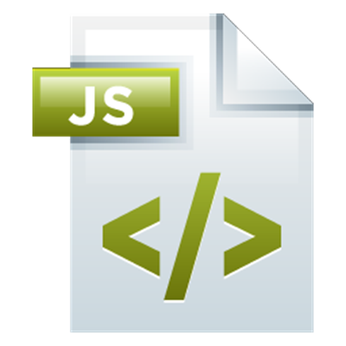
Unit Testing with Mocha
Unit Testing, Frameworks, Mocha, Chai, Tests Cases, Assertions, Hooks
Mocha
SoftUni Team
Technical Trainers
Software University
http://softuni.bg

Slide 2



Table of Contents
Unit Testing – Concepts
Using Mocha and Chai for JS Unit Testing
Testing with Mocha – Examples
Sum Array of Numbers
Check Array for Symmetry
Convert RGB to Hex Color
Add / Subtract Module

Slide 3
Have a Question?
sli.do #mocha

Slide 4




What is Unit Testing?

Slide 5
Unit Testing – Definition
A unit test is a piece of code, written by a developer that checks whether a piece of functionality (e.g. function or method), is working as expected.
Source code
Test code (unit tests)
function sortNums(arr) {
arr.sort(
(a,b) => a-b
);
}
let nums = [2, 15, -2, 4];
sortNums(nums);
if (JSON.stringify(nums)
!= "[-2,2,4,15]")
console.error("test failed!");

Slide 6



Unit Tests – Structure
The AAA Pattern: Arrange, Act, Assert
// Arrange all necessary preconditions and inputs
let nums = [2, 15, -2, 4];
// Act on the object or method under test
sortNums(nums);
// Assert that the obtained results are what we expect
if (JSON.stringify(nums) != "[-2,2,4,15]")
console.error("test failed!");

Slide 7


Unit Test – Sum Numbers – Example
function sum(arr) {
let sum = 0;
for (num of arr)
sum += Number(num);
return sum;
}
function testSum() {
if (sum([1, 2]) != 3) throw new Error("1+2 != 3");
if (sum([-2]) != -2) throw Error("-2 != -2");
if (sum([]) != 0) throw new Error("0 != 0");
}

Slide 8
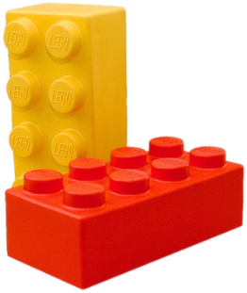

Unit Testing Framework
Unit testing frameworks make writing unit tests simple
Provides test cases, assertions, hooks, test runners, etc.
JUnit, NUnit, Visual Studio Team Test (VSTT), PHPUnit
JS unit testing: Mocha, QUnit, Unit.js, Jasmine, …
Assertion frameworks (perform checks)
Chai, Assert.js, Should.js
Mocking frameworks (mocks and stubs)
Sinon, JMock, Mockito, Moq

Slide 9
Mocha and Chai
Unit Testing in JavaScript

Slide 10
Mocha and Chai
Mocha is JS testing framework
Runs in Node.js and in Web browsers
Usually used together with Chai (assertion library)
let expect = require("chai").expect;
describe("sum(arr)", function() {
it("should return 3 for [1, 2]", function() {
expect(sum([1, 2])).to.be.equal(3);
});
});

Slide 11
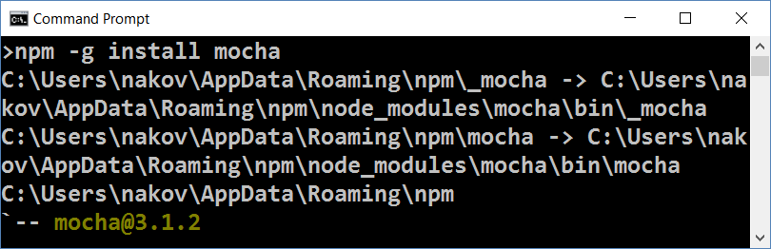
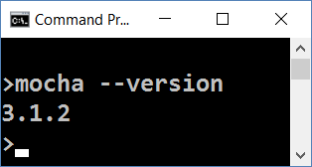
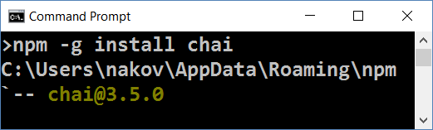
Installing Mocha and Chai
Install Mocha through npm
Check if Mocha is installed
npm -g install mocha
mocha --version
Install Chai through npm
npm -g install chai

Slide 12
Configuring NODE_PATH
By default Node.js does not find its globally-installed modules
You need to set the NODE_PATH environment variable
You may need to restart your IDE after changing NODE_PATH
rem for any future sessions
setx NODE_PATH %AppData%\npm\node_modules
rem for current session
set NODE_PATH=%AppData%\npm\node_modules

Slide 13
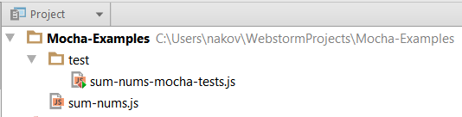
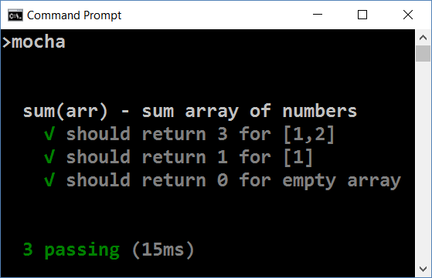
Running Mocha
Create folder "test" in your JS project
Put your test code in test/{test-group-name}.js
Run Mocha from the console
mocha

Slide 14
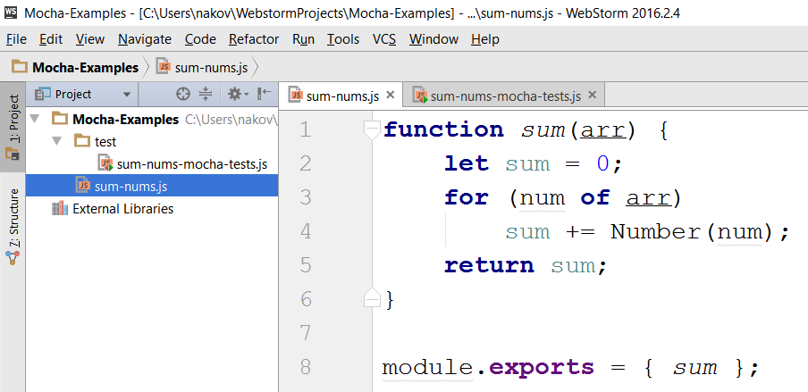
Mocha in Action – Sample Project
Source code to be tested

Slide 15
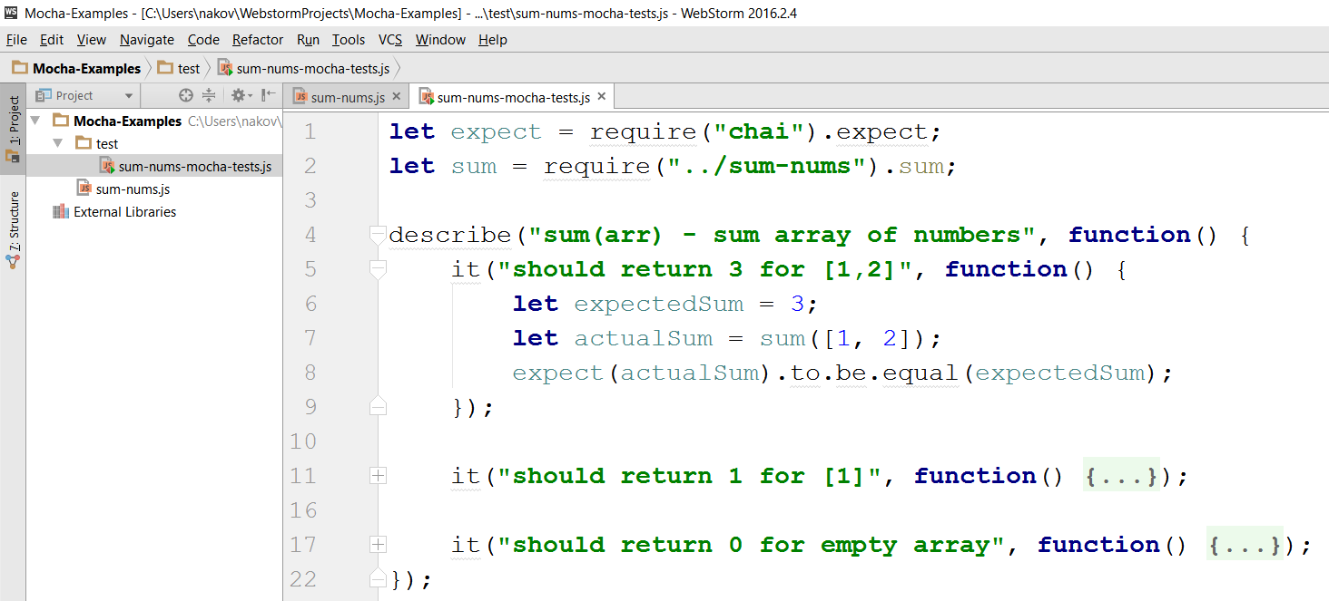
Mocha in Action – Sample Unit Tests
Tests for the sum(arr) function

Slide 16
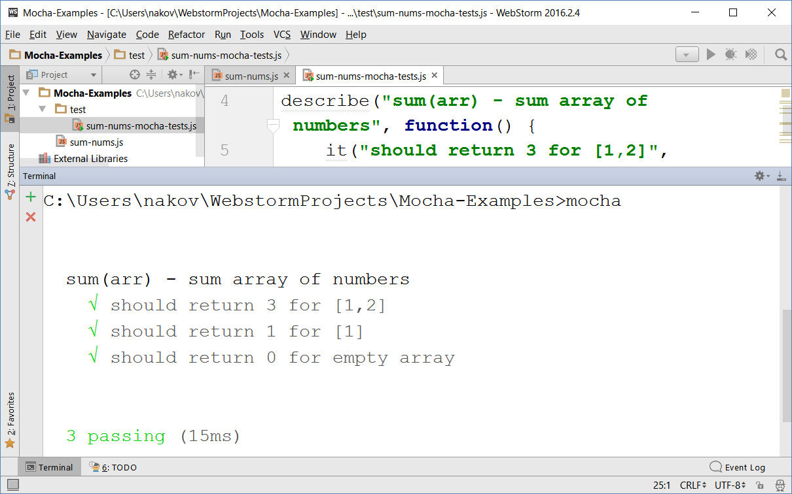
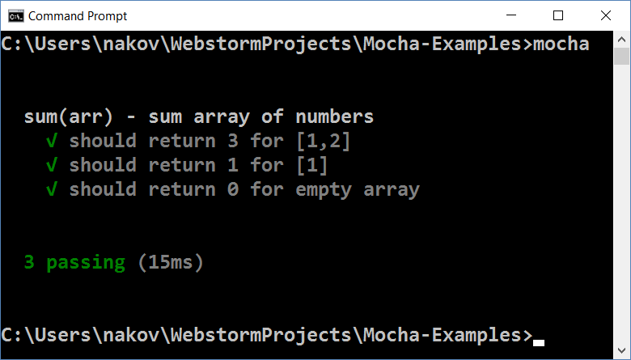
Mocha in Action – Running the Tests

Slide 17
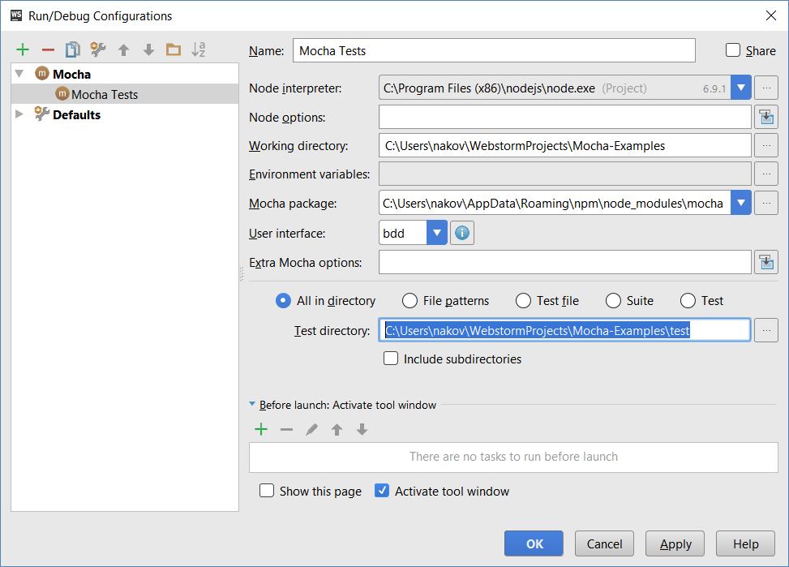
Running Mocha Tests from WebStorm

Slide 18

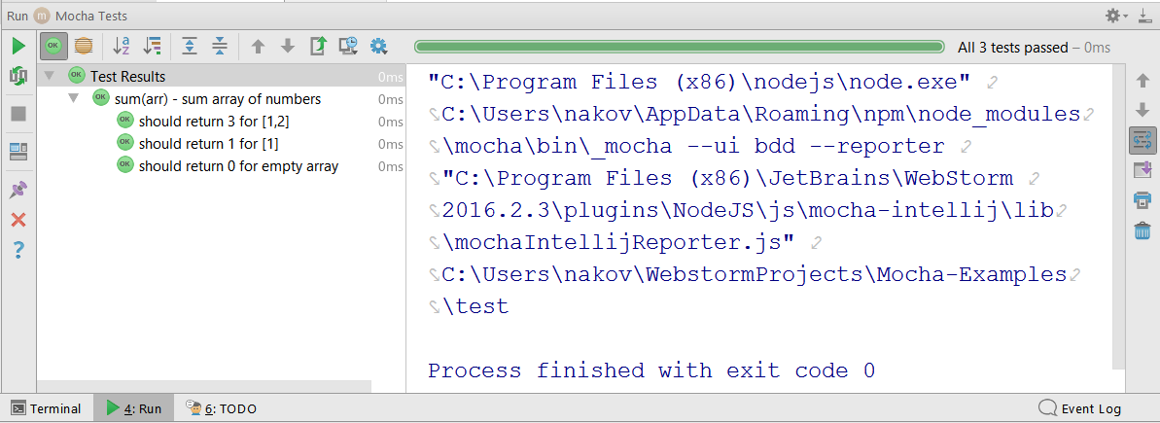
Running Mocha Tests from WebStorm (2)

Slide 19
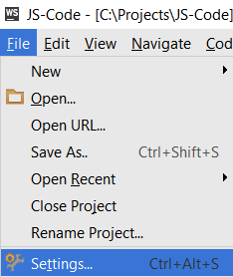
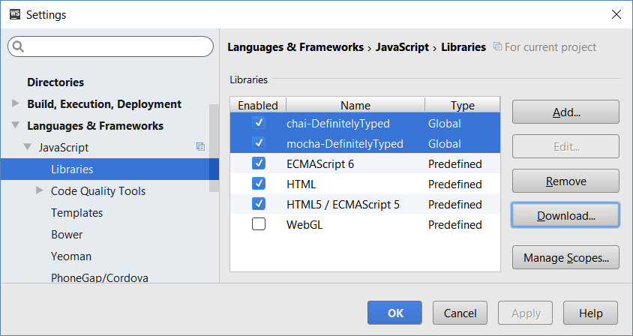
Configuring Libraries in WebStorm
To get the "auto complete" and "syntax checks" working for Mocha and Chai, add them as libraries in WebStorm

Slide 20
Test Groups and Test Cases
describe("Test group #1", function() {
it("should … when …", function() {
expect(actual).to.be.equal(expected);
});
it("should … when …", function() { … });
});
describe("Test group #2", function() {
it("should … when …", function() {
expect(actual).to.be.equal(expected);
});
…
});

Slide 21
Problem – Sum of Numbers
You are given a JS code intended to sum an array of numbers:
Write unit tests to test the sum(arr) function with Mocha
function sum(arr) {
let sum = 0;
for (num of arr)
sum += Number(num);
return sum;
}
Check your solution here: https://judge.softuni.bg/Contests/307

Slide 22

Solution – Sum of Numbers – Test Cases
Design the test cases
sum([1, 2]) → 3
sum([1]) → 1
sum([]) → 0
sum([1.5, 2.5, -1]) → 3
sum("invalid data") → NaN

Slide 23

Solution – Sum of Numbers – Test Code
describe("sum(arr) - sum array of numbers", function() {
it("should return 3 for [1, 2]", function() {
expect(sum([1, 2])).to.be.equal(3);
});
it("should return 1 for [1]", function() {
expect(sum([1])).to.be.equal(1);
});
it("should return 0 for empty array", function() { … });
it("should return 3 for [1.5, 2.5, -1]", function() { … });
it("should return NaN for invalid data", function() { … });
});
Check your solution here: https://judge.softuni.bg/Contests/307

Slide 24
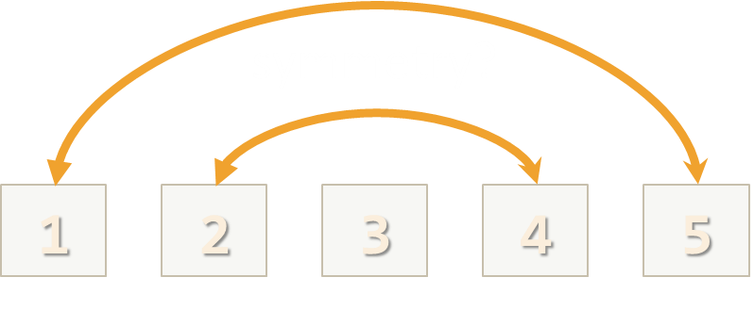
Problem – Check for Symmetry
You are given the following JS code:
Write unit tests to test the above function with Mocha
function isSymmetric(arr) {
if (!Array.isArray(arr))
return false; // Non-arrays are non-symmetric
let reversed = arr.slice(0).reverse(); // Clone + reverse
let equal =
(JSON.stringify(arr) == JSON.stringify(reversed));
return equal;
}
Check your solution here: https://judge.softuni.bg/Contests/307

Slide 25
Solution – Check for Symmetry – Test Cases
Design the test cases
[1,2,3,3,2,1] → true [1,2,3,4,2,1] → false
[-1,2,-1] → true [-1,2,1] → false
[1,2] → false [1] → true
[5,'hi',{a:5},new Date(),{a:5},'hi',5] → true
[5,'hi',{a:5},new Date(),{X:5},'hi',5] → false
1,2,2,1 → false (not an array)

Slide 26
Solution – Check for Symmetry – Test Code
describe("isSymmetric(arr) ", function() {
it("should return true for [1,2,3,3,2,1]", function() {
let symmetric = isSymmetric([1,2,3,3,2,1]);
expect(symmetric).to.be.equal(true);
});
it("should return false for [1,2,3,4,2,1]", function() { … });
it("should return true for [-1,2,-1]", function() { … });
it("should return false for [-1,2,1]", function() { … });
…
});
Check your solution here: https://judge.softuni.bg/Contests/307

Slide 27
Problem – RGB to Hex Color
Using Mocha write unit tests for the following function:
function rgbToHexColor(red, green, blue) {
if (!Number.isInteger(red) || (red < 0) || (red > 255))
return undefined; // Red value is invalid
if (!Number.isInteger(green) || (green < 0) || (green > 255))
return undefined; // Green value is invalid
if (!Number.isInteger(blue) || (blue < 0) || (blue > 255))
return undefined; // Blue value is invalid
return "#" +
("0" + red.toString(16).toUpperCase()).slice(-2) +
("0" + green.toString(16).toUpperCase()).slice(-2) +
("0" + blue.toString(16).toUpperCase()).slice(-2);
}

Slide 28
Solution – RGB to Hex Color – Test Cases
Design the test cases
Start from the typical (normal) cases
(255, 158, 170) → #FF9EAA
(12, 13, 14) → #0C0D0E
(0, 0, 0) → #000000
(255, 255, 255) → #FFFFFF
Then, test the special cases, e.g. invalid input
(-1, 0, 0), (0, -1, 0), (0, -1, 0) → undefined
(256, 0, 0), (0, 256, 0), (0, 0, 256) → undefined
(3.14, 0, 0), (0, 3.14, 0), (0, 0, 3.14) → undefined
("5", [3], {8:9}), (empty input) → undefined

Slide 29
Solution – RGB to Hex Color – Test Code
describe("rgbToHexColor(red, green, blue)", function() {
describe("Nominal cases (valid input)", function() {
it("should return #FF9EAA on (255, 158, 170)", function() {
let hex = rgbToHexColor(255, 158, 170);
expect(hex).to.be.equal('#FF9EAA');
});
…
});
describe("Special cases (invalid input)", function() {
…
});
});
Check your solution here: https://judge.softuni.bg/Contests/307

Slide 30
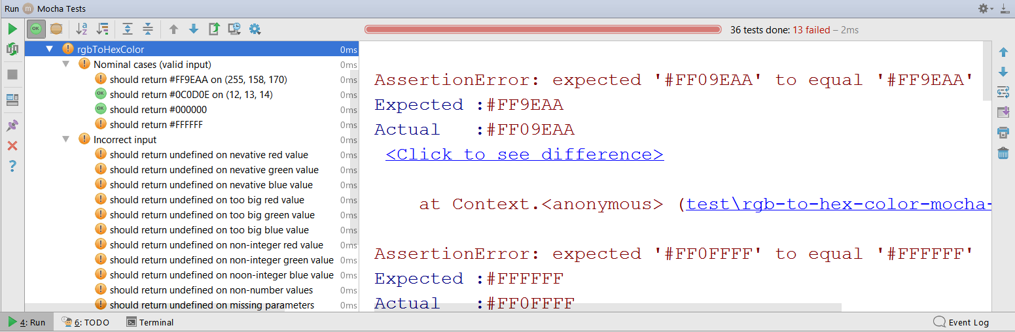
Testing Incorrect Code
function rgbToHexColor(red, green, blue) {
return "#" +
("0" + red.toString(16).toUpperCase()).slice(-2) +
("0" + green.toString(16).toUpperCase().slice(-2)) +
("0" + blue.toString(16).toUpperCase()).slice(-2);
}

Slide 31
Problem – Add / Subtract Module
You are given the following JS code:
Write unit tests to test the above code with Mocha
function createCalculator() {
let value = 0;
return {
add: function(num) { value += Number(num); },
subtract: function(num) { value -= Number(num); },
get: function() { return value; }
}
}
Check your solution here: https://judge.softuni.bg/Contests/307

Slide 32
Solution – Add / Subtract – Test Cases
Design the test cases
create; get → 0
create; add(2); add(3); get → 5
create; subtract(3); subtract(2); get → -5
create; add(5.3); subtract(1.1); get → 4.2
create; add(10); subtract('7'); add('-2'); subtract(-1); get → 2
create; add('hello'); get → NaN
create; subtract('hello'); get → NaN

Slide 33
Solution – Add / Subtract – Test Code
describe("createCalculator()", function() {
let calc;
beforeEach(function() {
calc = createCalculator();
});
it("should return 5 after {add 3; add 2}", function() {
calc.add(3); calc.add(2); let value = calc.get();
expect(value).to.be.equal(5);
});
…
});
Mocha hook: called before each test
Check your solution here: https://judge.softuni.bg/Contests/307

Slide 34

Practice: Unit Testing in JS
Live Exercises in Class (Lab)

Slide 35


Summary
Unit tests are programs that check whether a piece of code works as expected
Mocha + Chai are tools for JS unit testing
npm -g install mocha chai
let expect = require("chai").expect;
describe("sum(arr)", function() {
it("shoud sum 1+2 = 3", function() {
expect(sum([1, 2])).to.be.equal(3);
});
});
mocha

Slide 36









Unit Testing with Mocha
https://softuni.bg/courses/javascript-advanced

Slide 37
License
This course (slides, examples, demos, videos, homework, etc.) is licensed under the "Creative Commons Attribution-NonCommercial-ShareAlike 4.0 International" license

Slide 38






Free Trainings @ Software University
Software University Foundation – softuni.org
Software University – High-Quality Education, Profession and Job for Software Developers
softuni.bg
Software University @ Facebook
facebook.com/SoftwareUniversity
Software University @ YouTube
youtube.com/SoftwareUniversity
Software University Forums – forum.softuni.bg

